Slide 1
Adversarial attack & defense
Team 26
Notes:
Hello everyone.
This is Team 26
Our topic is Adversarial attack and defense.

Slide 2
Outline
Introduction(0.5)
Method(4.2)
Attack(2.5)
Introduction
Results
Defense(1)
Passive Defense
Defensing results
Future Work(0.3)
Universal Attacking
Proactive Defense
Notes:
here’s our presentation’s outline.

Slide 3
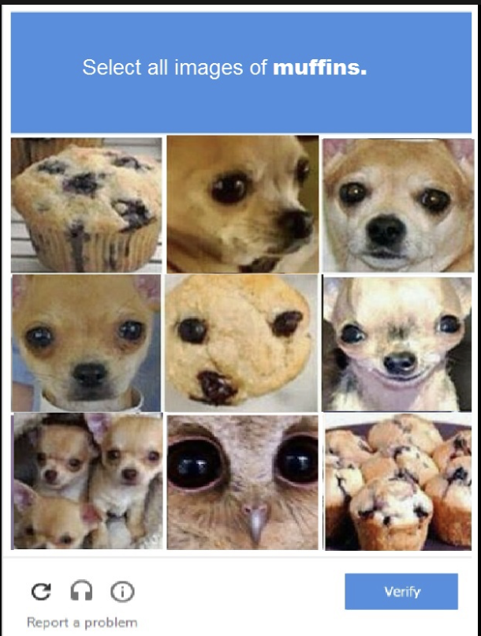
Introduction
ML techonologies is widely used in everyday life
False detection/prediction may lead to fetal results
ex. when self-drive car can’t detect pedestrian…?
Adversarial attack
mislead model on purpose
Notes:
Machine learning is widely used in everyday life, and may be used to make important decisions.
Thus, a false detection or prediction may lead to fatal results.
Adversarial attack is one method to mislead models on purpose.
So, defending adversarial attack is important when designing, training models.

Slide 4
Adversarial Attack
Notes:
To know how to defend adversarial attacks, we first need to know what it is.

Slide 5
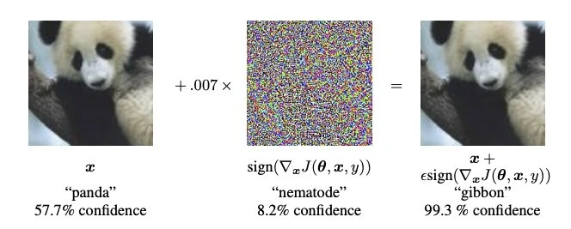
Adversarial Attack
What is adversarial attack?
Adversarial examples
an input designed for misleading models
the difference shouldn’t be detected by human
Use adversarial examples to deceive models
Notes:
what is adversarial attack?
Adversarial attack is to use adversarial examples to make models generate wrong result.
Then
Adversarial examples are some inputs designed on purpose to mislead model,
it is generated by adding some signals that human can’t detect.
The following figure is the flow.

Slide 6
Adversarial Attack(cont’d)
Adversarial knowledge
What does the attacker knows?
White box attack
Attacker knows every details about the model
ex. model structure, model parameters…etc
Black box attack
Attacker knows less about the model
Adversarial goals
Is the misguide direction specified?
Targeted attack: lead to a specific class
Untargeted attack: on the contary
Notes:
There are many types of attacking.
We can divide them into white box attack and black box attack according
what attacker knows about the model details.
We can also divide them into targeted attack and untargeted attack
according what the attacking goal is.

Slide 7
Adversarial Attack(cont’d)
We attack on MobileNet
An image classifing model
Training on dataset ImageNet
Full model’s detail is avaliable online
Adversarial attack method
FGSM
I-FGSM
Notes:
in our project, we will attack on MobileNet using FGSM and I-FGSM

Slide 8
FGSM
Notes:
What is FGSM?

Slide 9
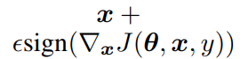
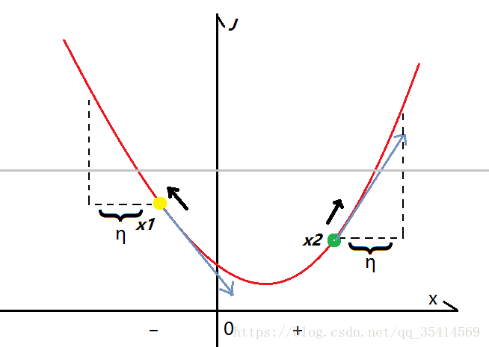
FGSM: Fast Gradient Sign Method
FGSM is a method to maximize the loss
Add perturbations to original x：
Variables： θ: parameters of a model; x: input; y: label; epsilon: the bound for perturbation; once it exceeds a certain threshod, the disturbance would be discovered by human eyes. sign(): not gradient value; in order to control the perturbation :derivative function w.r.t x J(θ, x, y) be the cost used to train the neural network.
Notes:
FGSM use the gradient of loss function to maximize the loss, because we want the model to misclassify.
This is the FGSM equation.
Backpropagation is used to calculate the gradient of the loss function with respect to the parameters.
θ are parameters of a model
x is input; y is label;
epsilon is the bound for perturbation; and once it exceeds a certain threshod, the disturbance would be discovered by human eyes.
sign() function returns not a gradient value in order to control the perturbation
loss function is the cost used to train the neural network.

Slide 10
FGSM: White & Black box Implementations
White Box Attack
FGSM needs θ (mobel parameters) in J(θ, x, y)
Have “backward” process when coding
Black Box Attack
We do not know θ
Do gradient on predictions & label loss function Apply the result DIRECTLY on the J(θ, x, y) part
Notes:
Since FGSM needs parameters of the model when caculating the gradient of loss function, it can be implemented on white box attack.
When doing black box attack, we do gradient on input label & loss function, and
Apply the result DIRECTLY on the loss function part

Slide 11
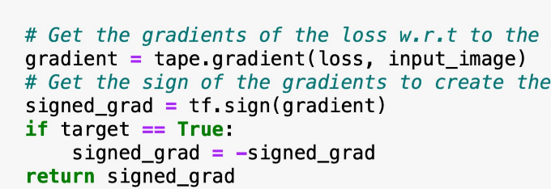

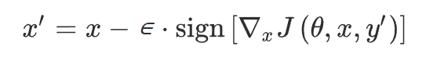
FGSM: Targeted & Untargeted
Untargeted: we want the loss to be as large as possible:
Targeted:
untargeted implementations + minimize the value of loss (targeted label, predictions) You can imagine that it returns to the original intention of doing gradient !
Notes:
In untargeted version, we try to maximize the loss as we mention before.
And for the targeted version,
we have to minimize the cost of target label and the predictions, because we want the result to be close to the target label.
So we put a minus sign in front of the loss function!

Slide 12
Attacking Result

Slide 13
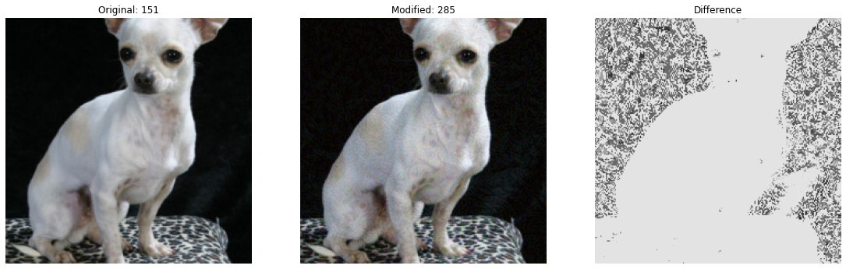
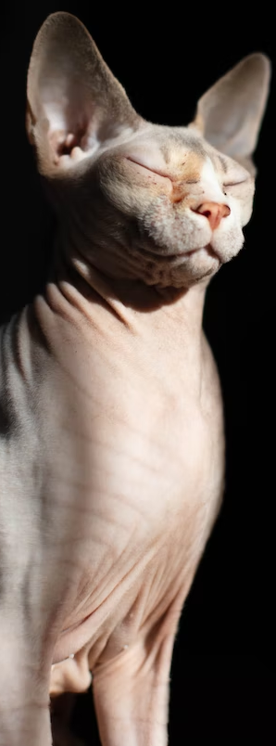
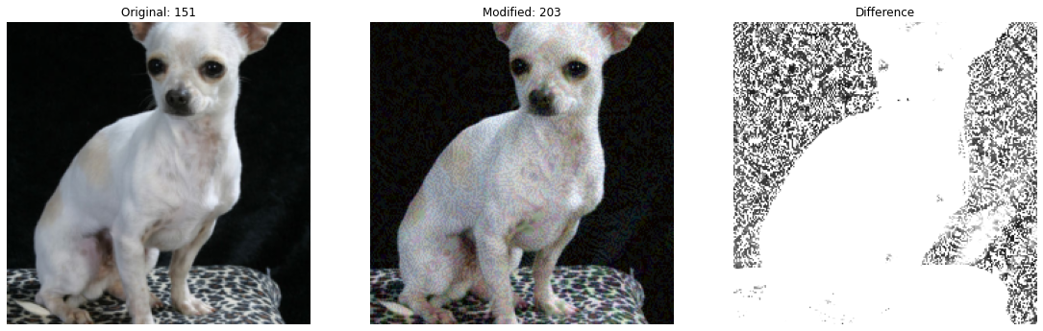
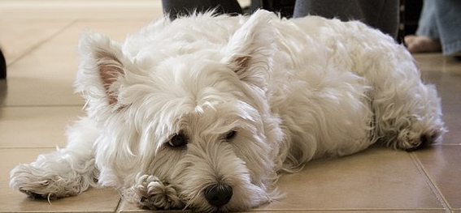
White Box Attack - Result
chihuahua
egyptian_cat
One shot FGSM(1s)
Untargeted
epsilon=0.1
Resulting class is close to original class
Targeted (failed)
target: diaper
Success rate is very low
epsilon=0.18 (更多會失真)
West_Highland_white_terrier
Notes:
Here is the result of white box attack using one shot FGSM.
in untargeted attack, we successfully attack it, but the resulting class is close to the original class.
The model still can identify the picture as an animal.
In targeted attack, the success rate is low
The following figure illustrates a failure attack.

Slide 14
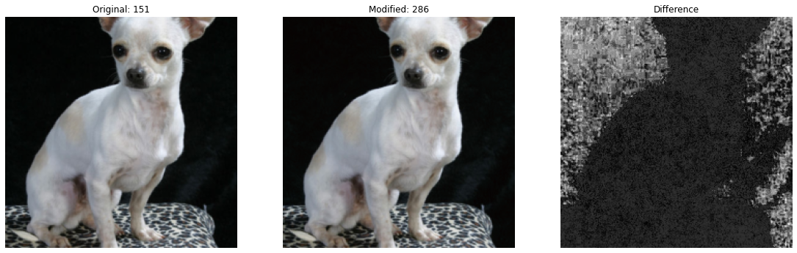
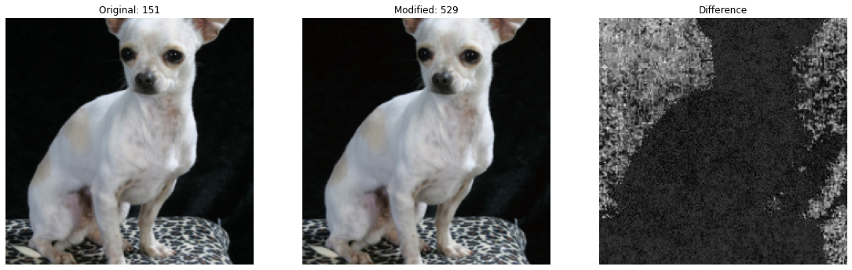
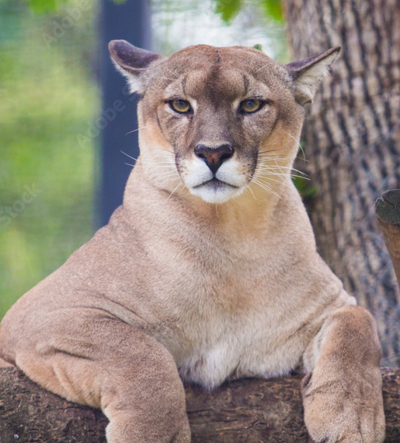
White Box Attack - Result
chihuahua
diaper
I-FGSM
Untargeted
Fooled in 8 iters(2s)
epsilon=0.001
Targeted
Fooled in 9 iters(2s)
epsilon=0.001
chihuahua
cougar
Notes:
we can also use I-FGSM to improve performance.
the overall result is much better, but needs more runtime.

Slide 15
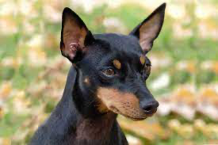
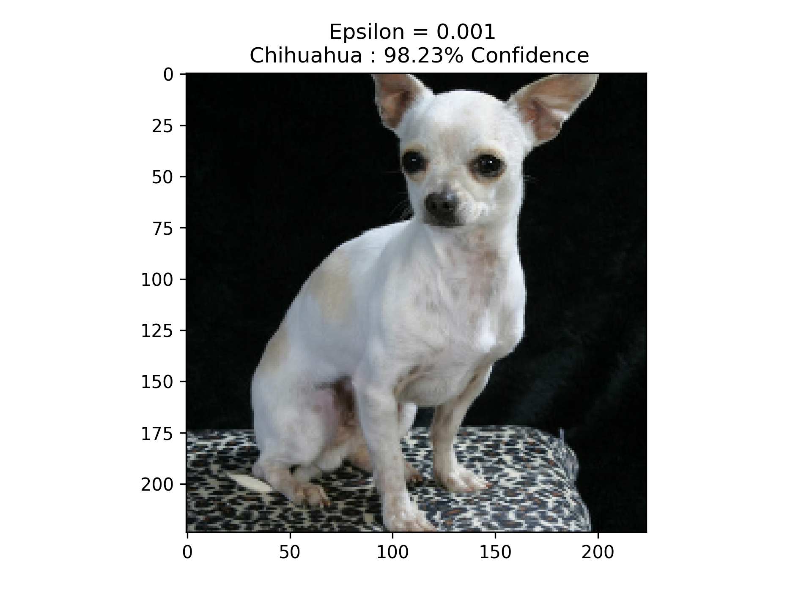
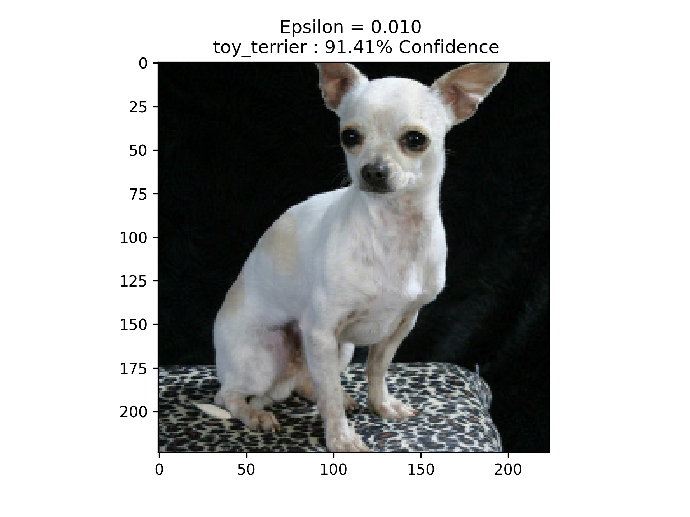
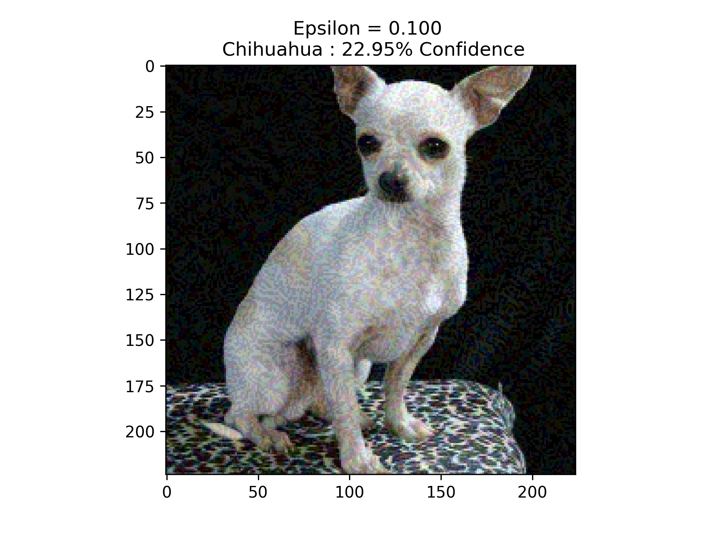

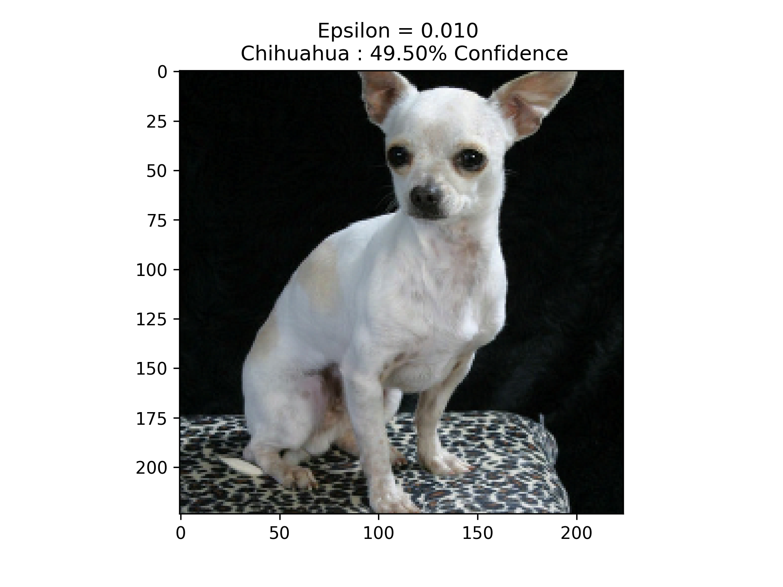

Black Box Attack - Result
One shot FGSM: 0.05s
Untargeted
Unstable results
Resulting class is close to original class
Targeted
Target: diaper
Success rate is lower than untargeted attack
Notes:
Here is the result of Black box attack using one shot FGSM.
we can see that the runtime is faster.
In untargeted attack, its success rate is lower than white box attack.
In targeted attack, its success rate is lower than untargeted attack.
The following figure illustrates a failure attack.

Slide 16
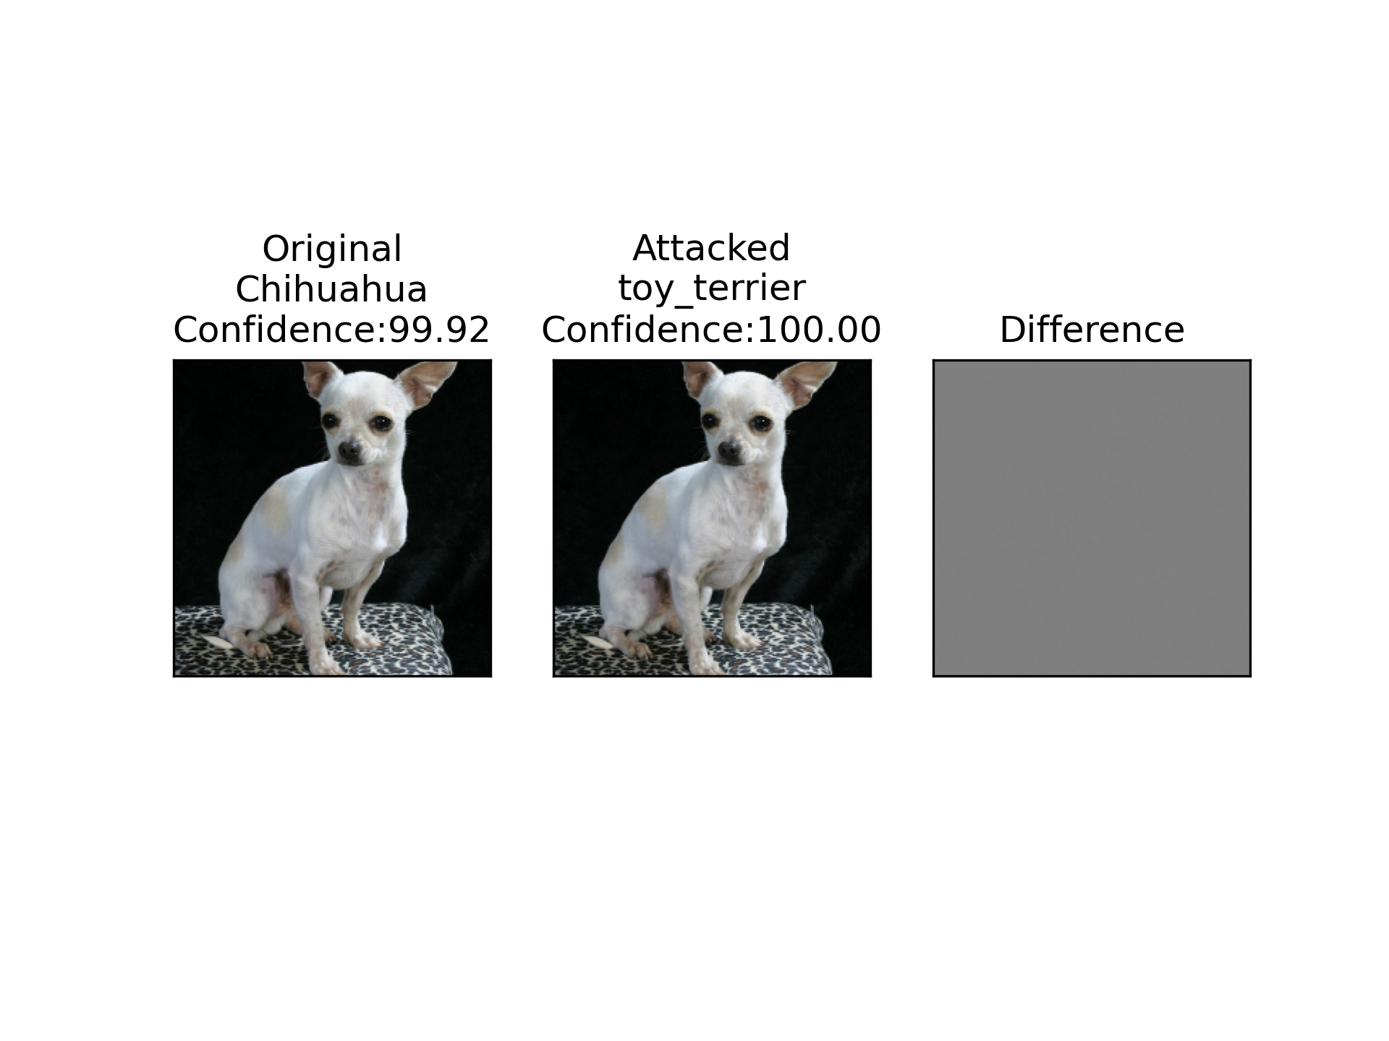
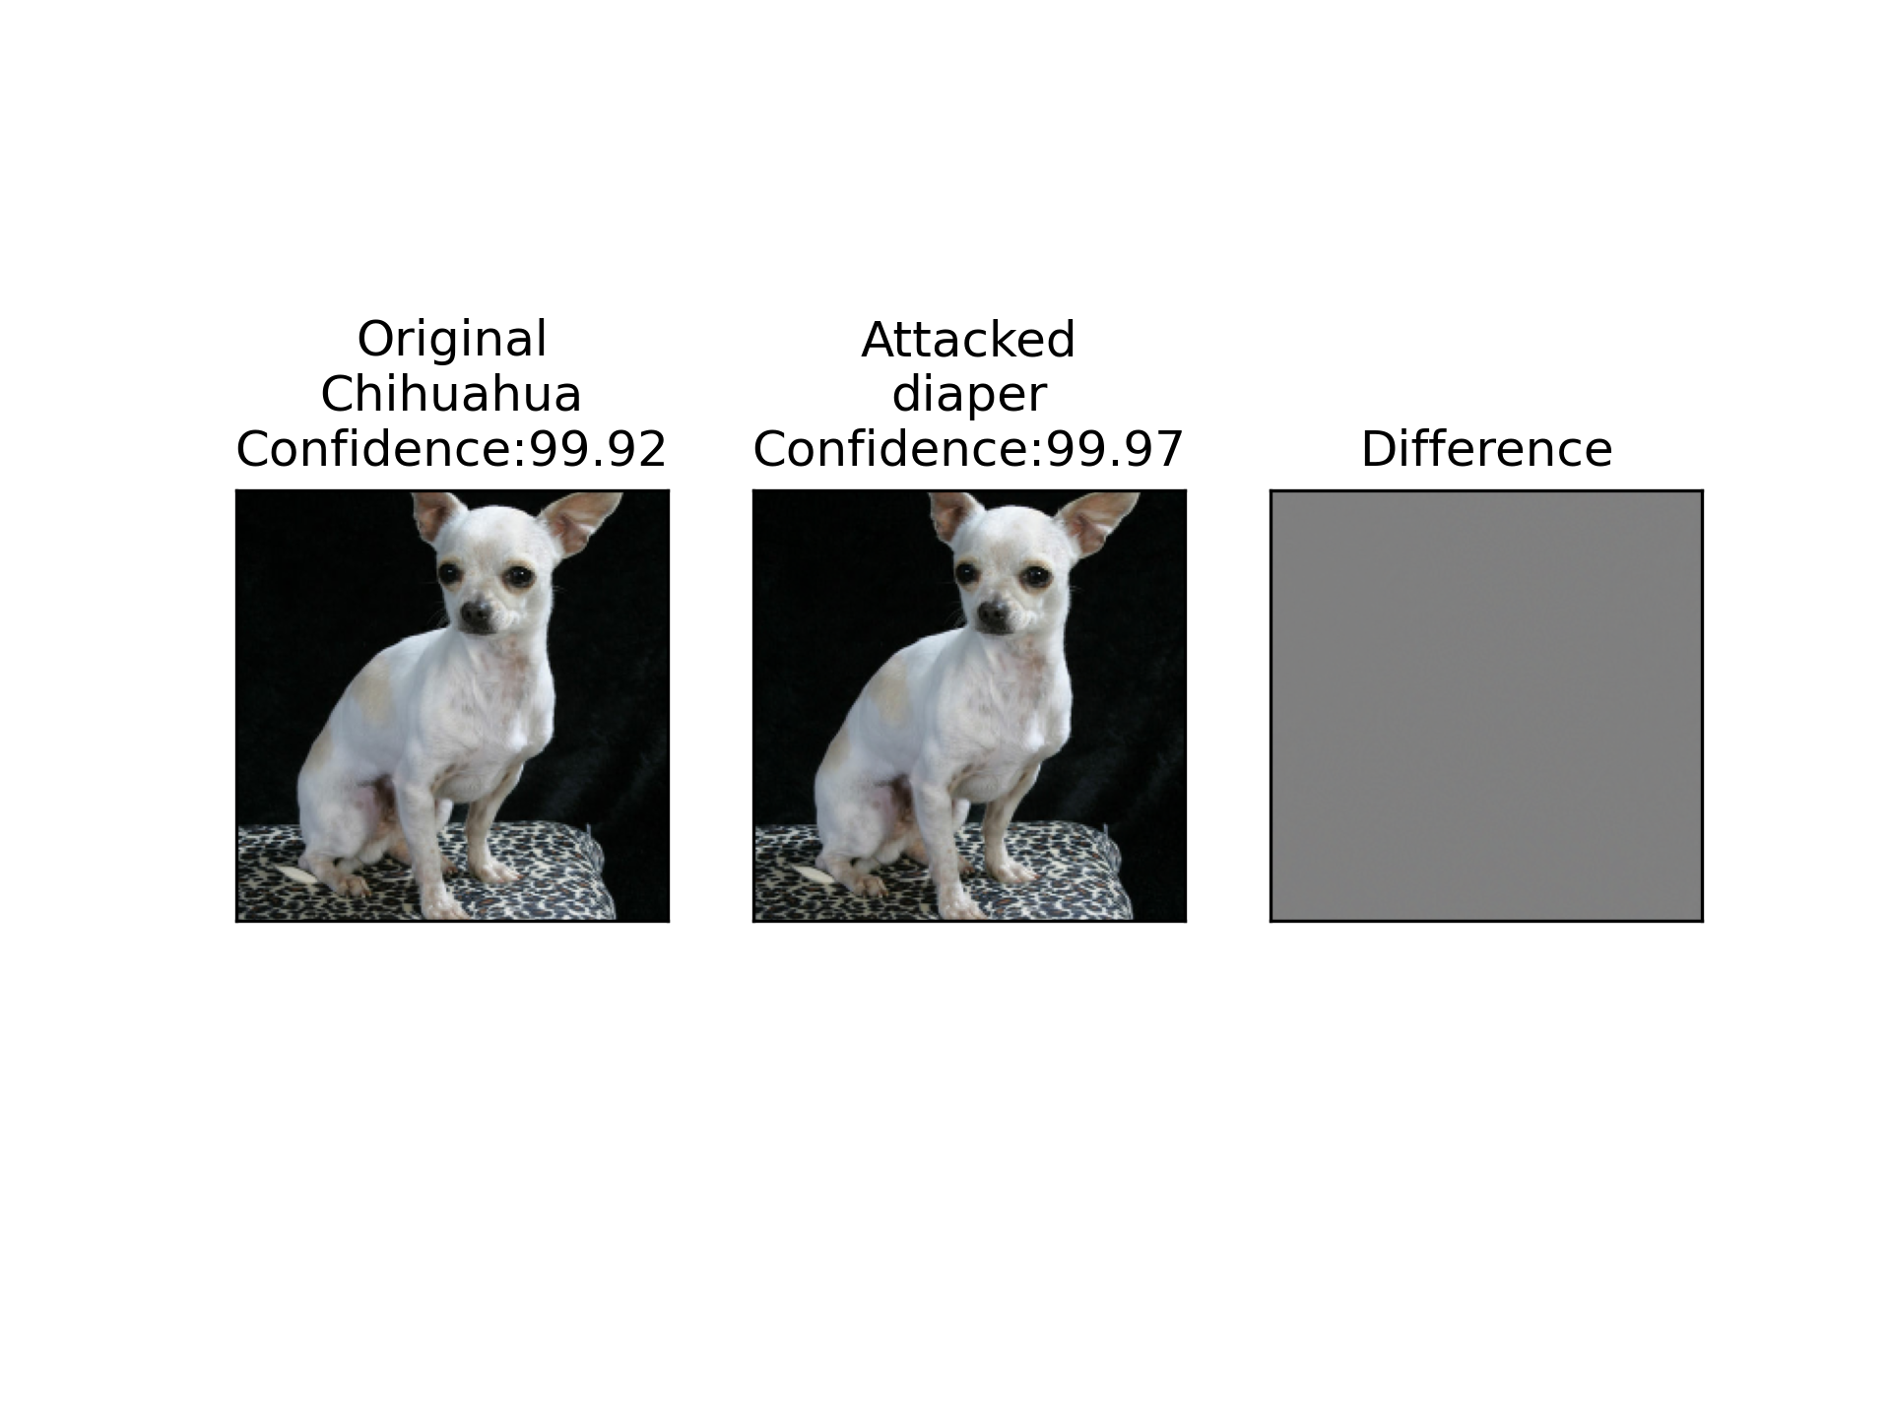
Black Box Attack - Result
I-FGSM
Untargeted
Resulting class is close to original class
Fool model in 3 iters (0.15s)
eps = 0.001
Targeted
Tatget: diaper
Fool model in 5 iters (0.25s)
eps = 0.001
Notes:
we can also use I-FGSM to improve performance.
The overall result is much better.

Slide 17
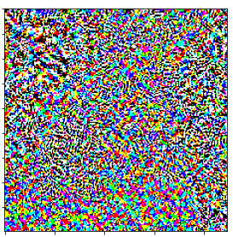
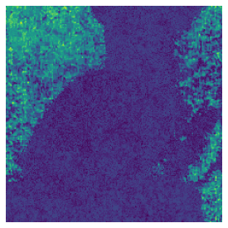
Conclusion
I-FGSM’s is better than one shot FGSM
White box attack more robust than black box attack
The added perturbations are different
black box
white box
Notes:
In conclusion
I-FGSM’s is better than one shot FGSM
and
White box attack is more robust than black box attack.
The perturbations added on two attacks are different
Perturbations of white box attack is more related to input image.

Slide 18
Defense

Slide 19
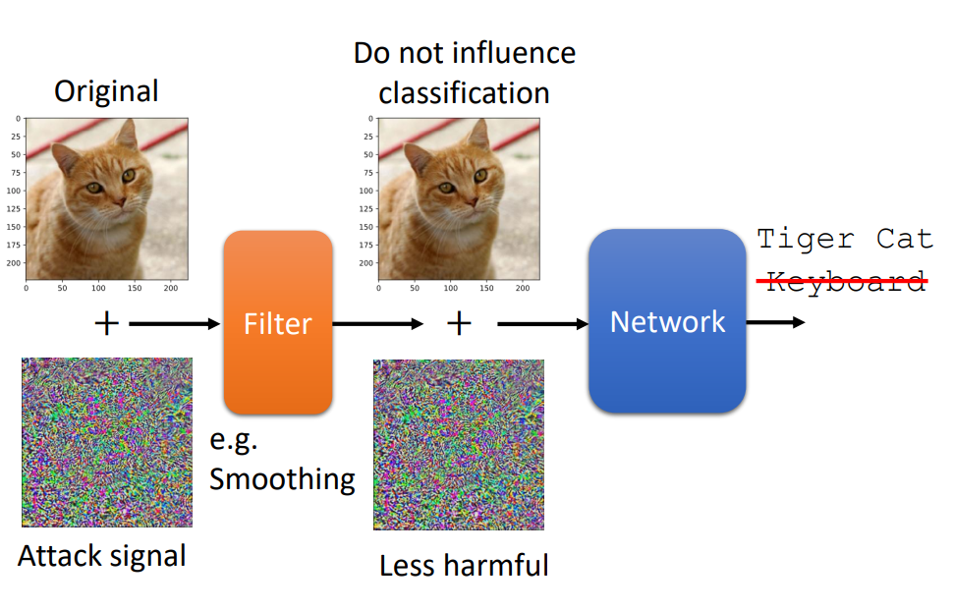
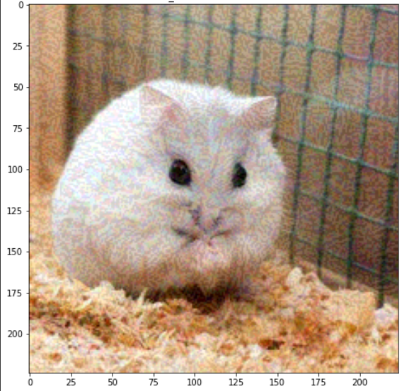
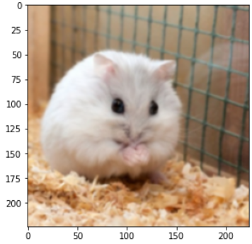
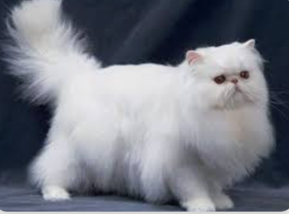
Passive Defense
Adding a filter as a shield before data input.
Reduce the influence of images being attack.
No effect on those are not attacked.
Our implementation using Gaussian blurring.
Example Flow Chart：
persian cat
hamster
persian cat
Notes:
Passive defense means not changing the model itself, but only add a filter as a shield before data input to the model for resisting attacks.
This Filter can reduce the influence of the signal added by the attack to the image, and has no effect on those are not attacked.
The method of Filter can simply blur the picture, which can achieve a good defense effect.
In our implementation, we try to use Gaussian blurring.
Here is the example flow chart, through the filter, the misled prediction as a persian cat return back to a hamster.

Slide 20
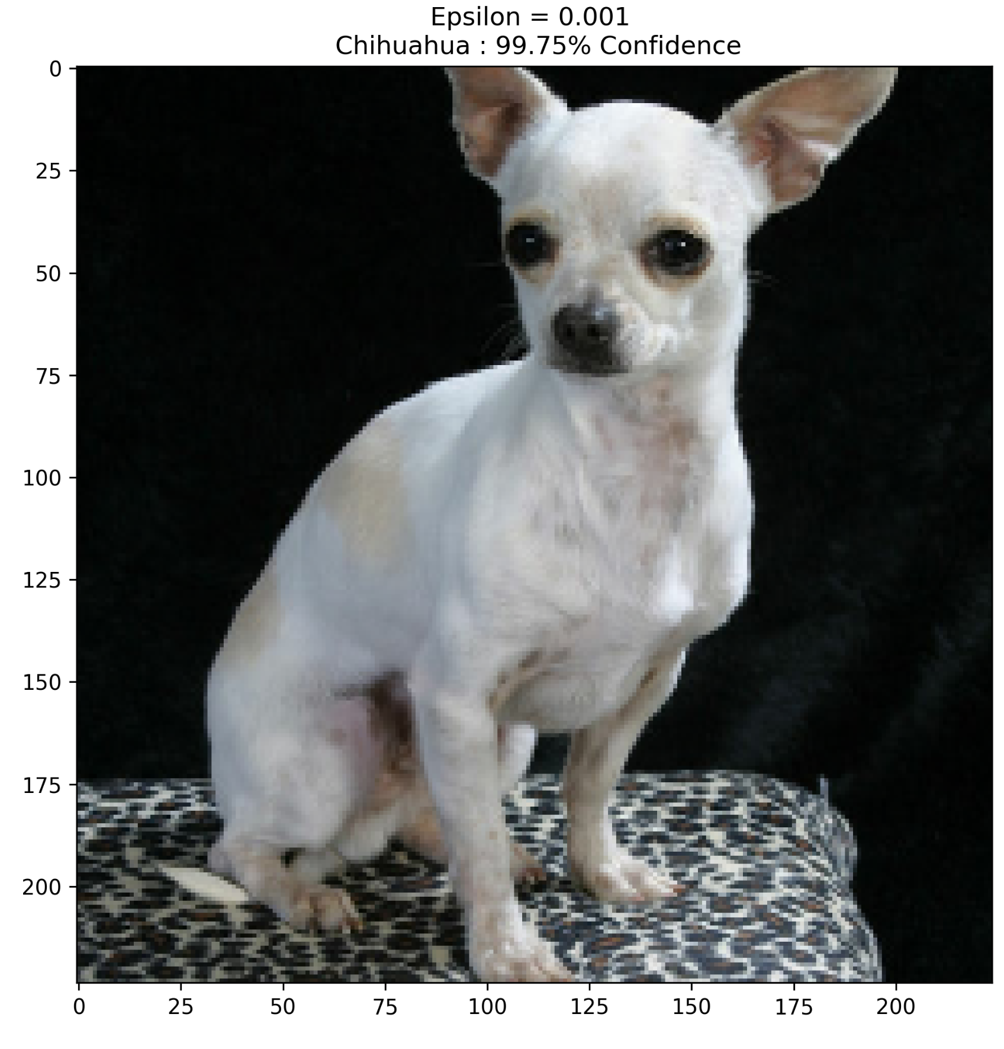
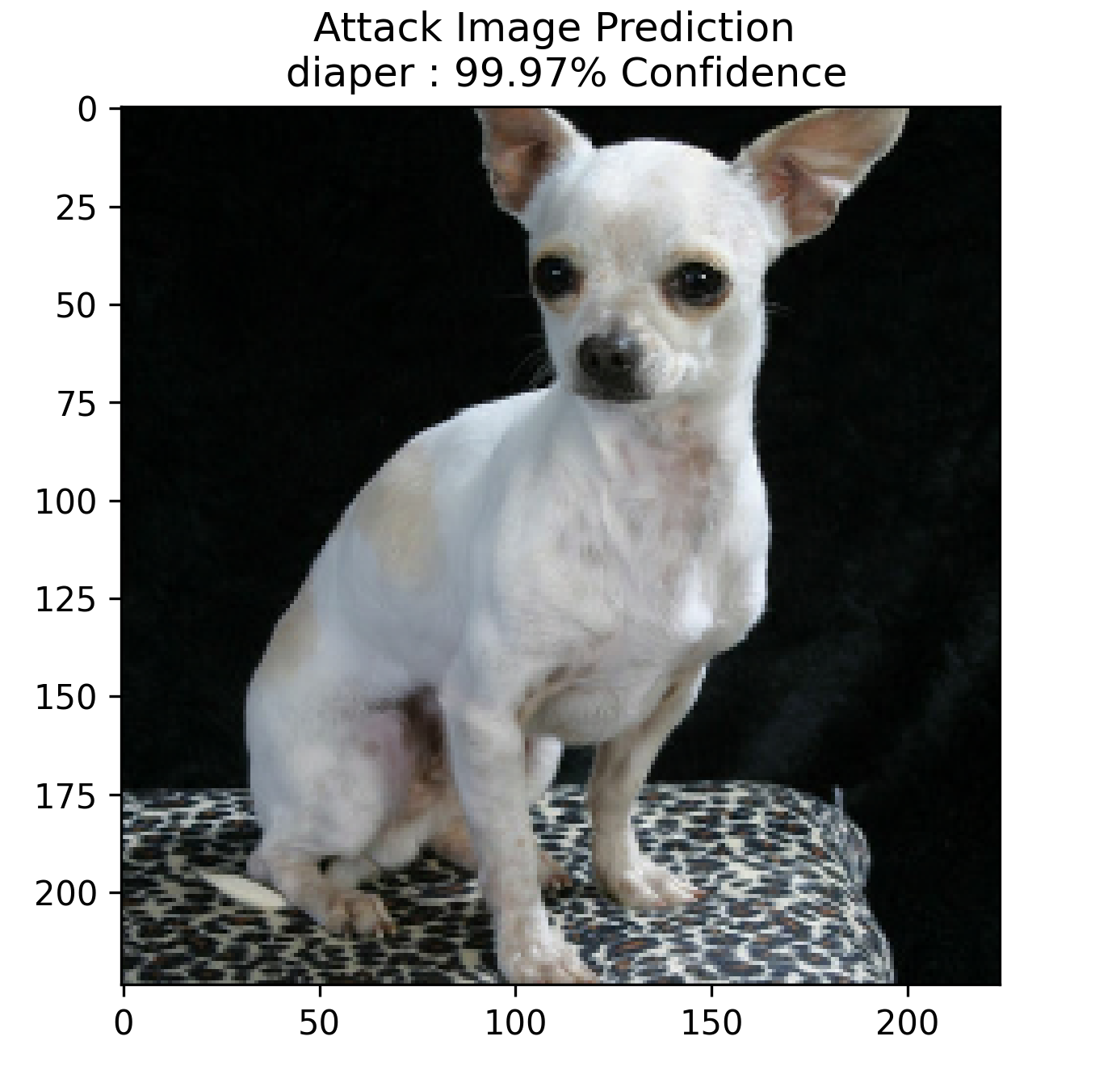
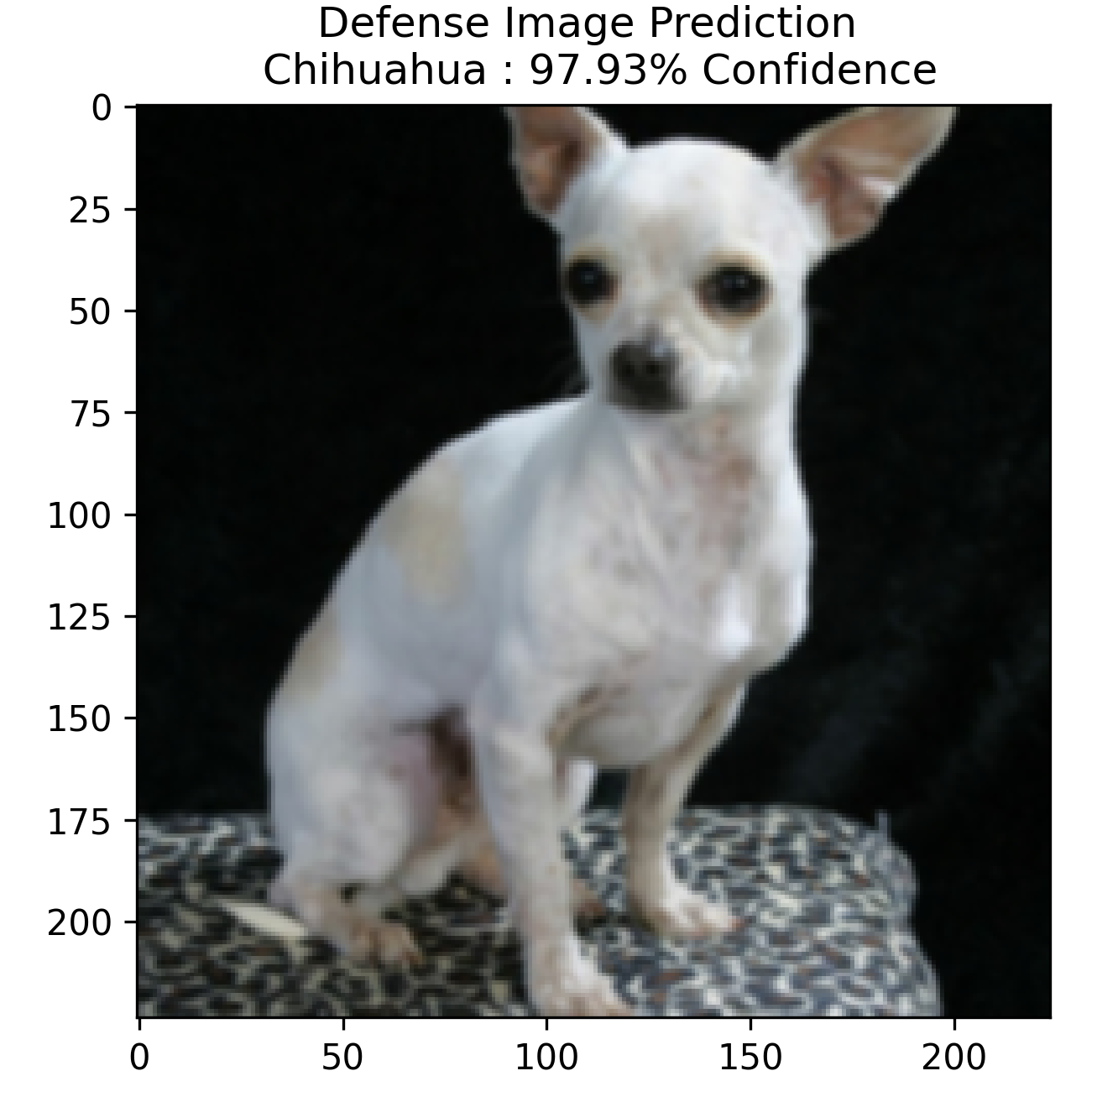
Result
Original Image Be Attacked Defense
Chihuahua Diaper Chihuahua
Notes:
Here is our result.
Original prediction is Chihuahua.
After being attacked by targeted Black Box Attack, the prediction FALSE.
It became a Diaper rather than a Chihuahua.
We can see that after applying the gaussian blurring filter, the Image obviously became blur.
Then put it into the model.
The prediction return to Chihuahua.

Slide 21
Future Work

Slide 22

Future Work
Momentum FGSM
Universal Attacking
Proactive Defense
Notes:
Here are some works we can do in the future to improve our framework.

Slide 23
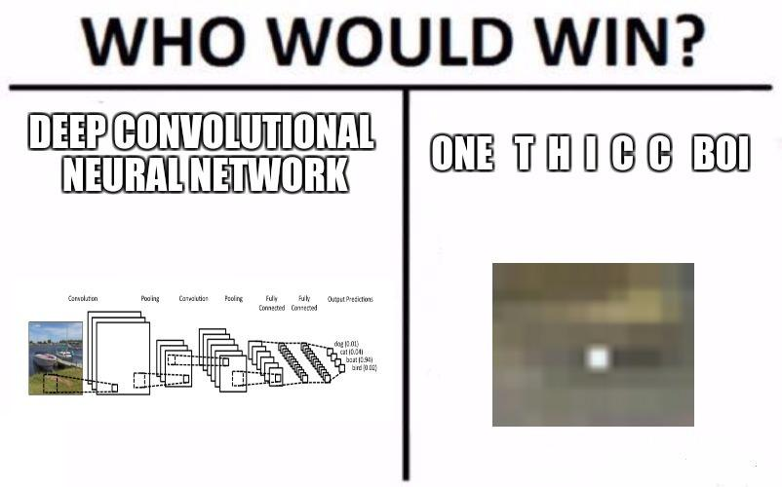
The End!
Notes:
OK That’s All !

